Slide 1
Machine Learning Foundations and Applications
Jiaul Paik

Slide 2
Today’s topics
Optimization for Deep Learning
Gradient Descent
Stochastic Gradient Descent

Slide 3
Basic Math

Slide 4
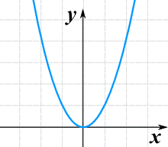



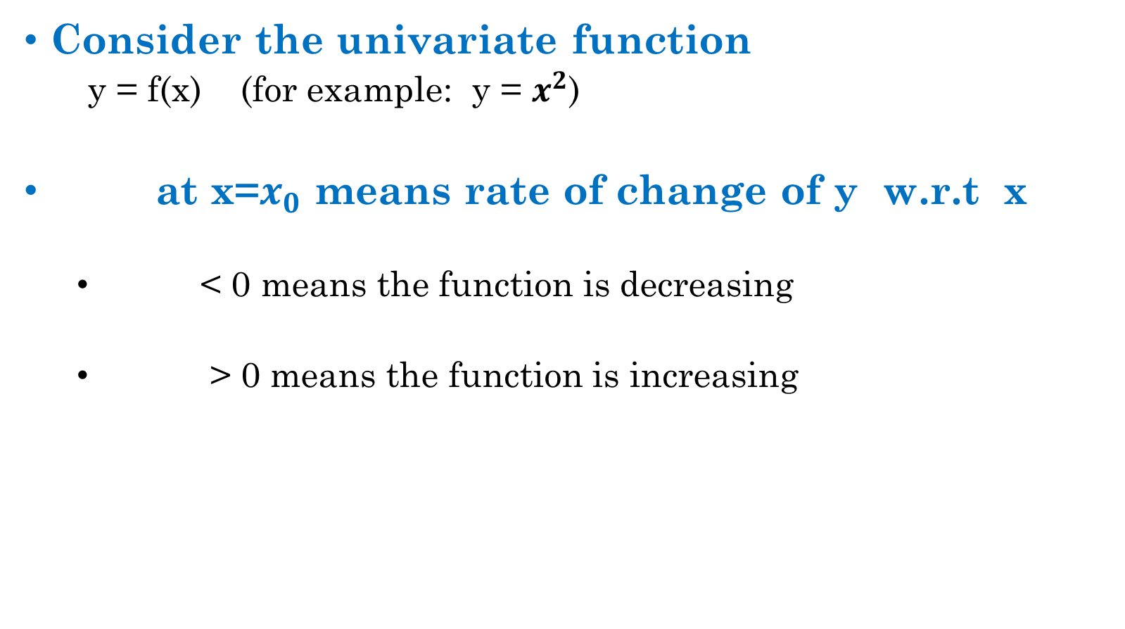


Review of Differential Calculus
Consider the univariate function
y = f(x) (for example: y = $x^{2}$)
at x=$x_{0}$ means rate of change of y w.r.t x
< 0 means the function is decreasing
> 0 means the function is increasing
$$\frac{dy}{dx}$$
$$\frac{dy}{dx}$$
$$\frac{dy}{dx}$$
What is the sign of here?
$$\frac{dy}{dx}$$
$$\frac{dy}{dx}$$
What is the sign of here?

Slide 5
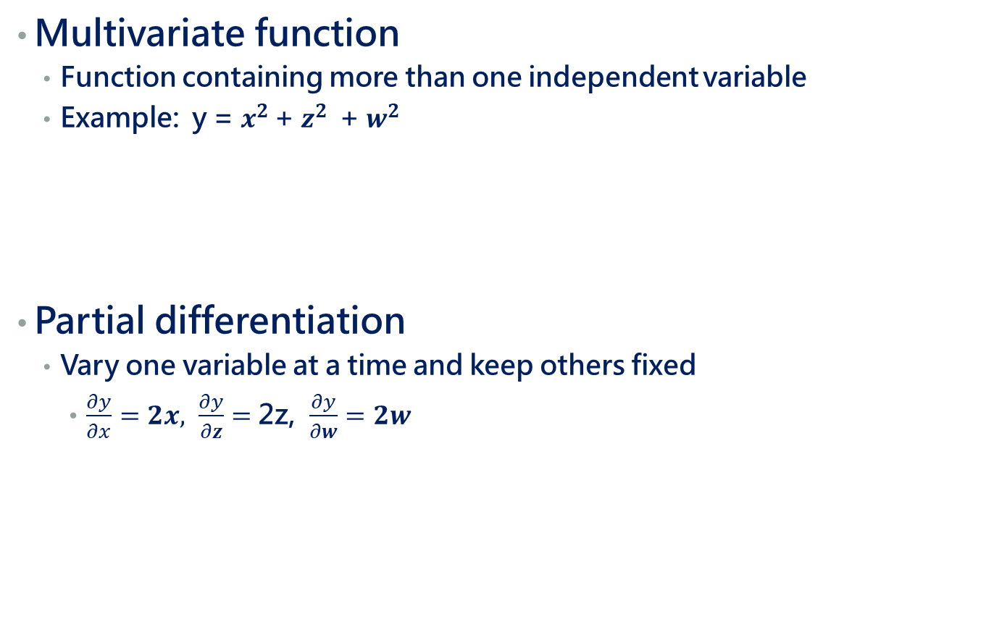
Review of Differential Calculus
Multivariate function
Function containing more than one independent variable
Example: y = $x^{2 }$+ $z^{2 }$ + $w^{2 }$
Partial differentiation
Vary one variable at a time and keep others fixed
$\frac{∂y}{∂x}=2x, \frac{∂y}{∂z}=$ 2z, $\frac{∂y}{∂w}=2w$

Slide 6
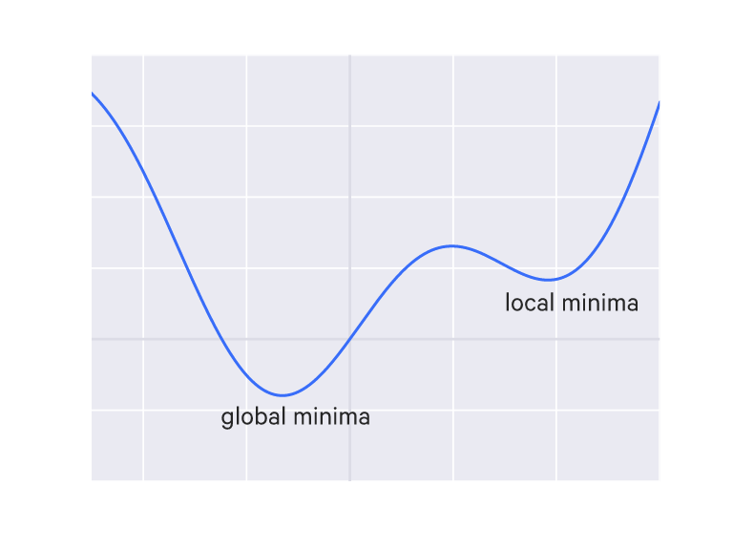
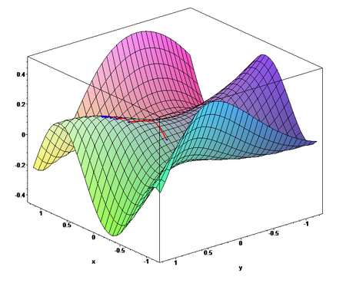
Local and Global minima
F(x)
x
Univariate: Curve
Multivariate: Surface

Slide 7
Nature of the Functions
In ML the objective function almost always multivariate
The function must be continuous for gradient-descent based optimization
Differentiability is a desirable condition
We can still manage a non-differentiable function well

Slide 8
Gradient Descent

Slide 9
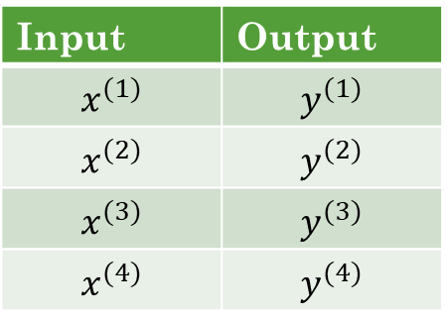
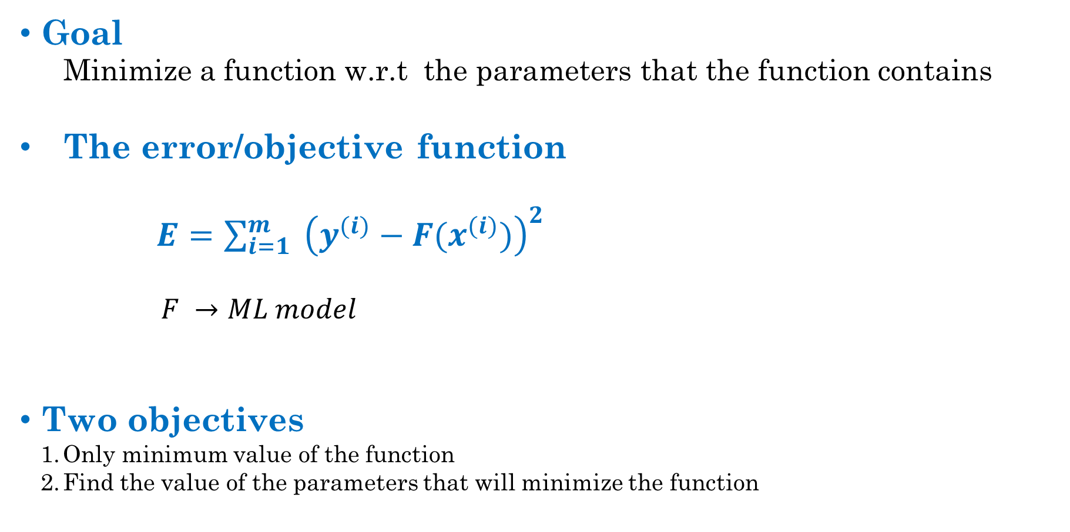
Gradient Descent
Goal
Minimize a function w.r.t the parameters that the function contains
The error/objective function
$E=\sum_{i=1}^{m}{ {\left(y^{(i)}−F(x^{(i)})\right)}^{2}}$
$F →ML model$
Two objectives
Only minimum value of the function
Find the value of the parameters that will minimize the function
Training data
Input | Output
$$x^{(1)}$$ | $$y^{(1)}$$
$$x^{(2)}$$ | $$y^{(2)}$$
$$x^{(3)}$$ | $$y^{(3)}$$
$$x^{(4)}$$ | $$y^{(4)}$$

Slide 10
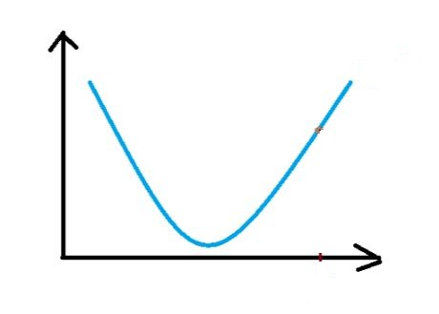



Gradient Descent
Role of gradient descent
To find the values of parameters that minimize an objective function
1. If we start from red circle, what is the direction of movement?
Ans: downward
2. How can we get that?
Ans: by looking at the derivative
3. What is the sign of $\frac{dF\left(θ \right)}{dθ }$ ?
Ans: positive
Then, which direction we should move?
Ans: - $\frac{dF\left(θ \right)}{dθ }$
How to change parameter to reach minimum?
$θ_{new}= θ_{old }$- $r ∗ \frac{dF\left(θ \right)}{dθ }$
r > 0 (scalar) is a parameter called rate constant
F($θ$)
$$θ$$
we want to reach here

Slide 11



Gradient Descent: Demonstration
Update rule:${ θ}^{t+1}=θ^{t}$ - $r ∗ \frac{dF\left(θ \right)}{dθ}$
F($θ$)
starting position
starting position
After first update
After first update
After second update
After second update
After third update
$$θ$$
we want to reach here

Slide 12
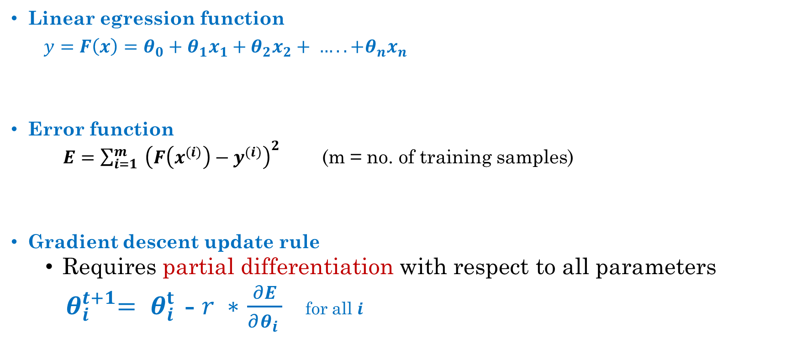
Gradient Descent on Multivariate Function
Linear egression function
$y=F\left(x\right)=θ_{0}+θ_{1}x_{1}+θ_{2}x_{2}+ ….. +θ_{n}x_{n}$
Error function
$E=\sum_{i=1}^{m}{ {\left(F\left(x^{(i)}\right)−y^{(i)}\right)}^{2}}$ (m = no. of training samples)
Gradient descent update rule
Requires partial differentiation with respect to all parameters
${ θ}_{i}^{t+1}= θ_{i }^{t}$- $r ∗$ $\frac{∂E}{∂θ_{i }}$ for all $i$

Slide 13
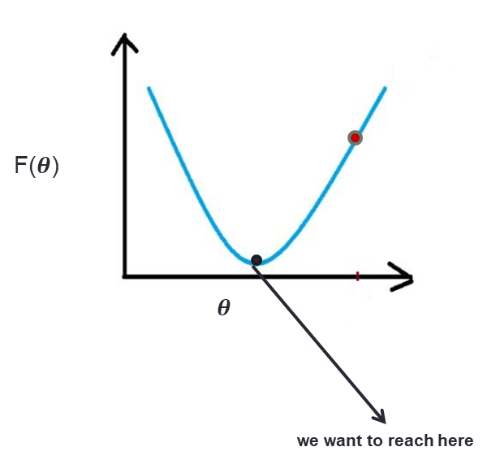
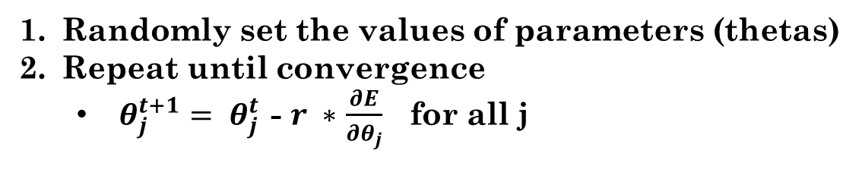
Gradient Descent Algorithm
Randomly set the values of parameters (thetas)
Repeat until convergence
$θ_{j }^{t+1}= θ_{j }^{t}$- $r ∗$ $\frac{∂E}{∂θ_{j}}$ for all j
How to check convergence?
Two widely used approaches
Iterate a fixed number of times
Stop if parameters do not change much in two consecutive iteration

Slide 14
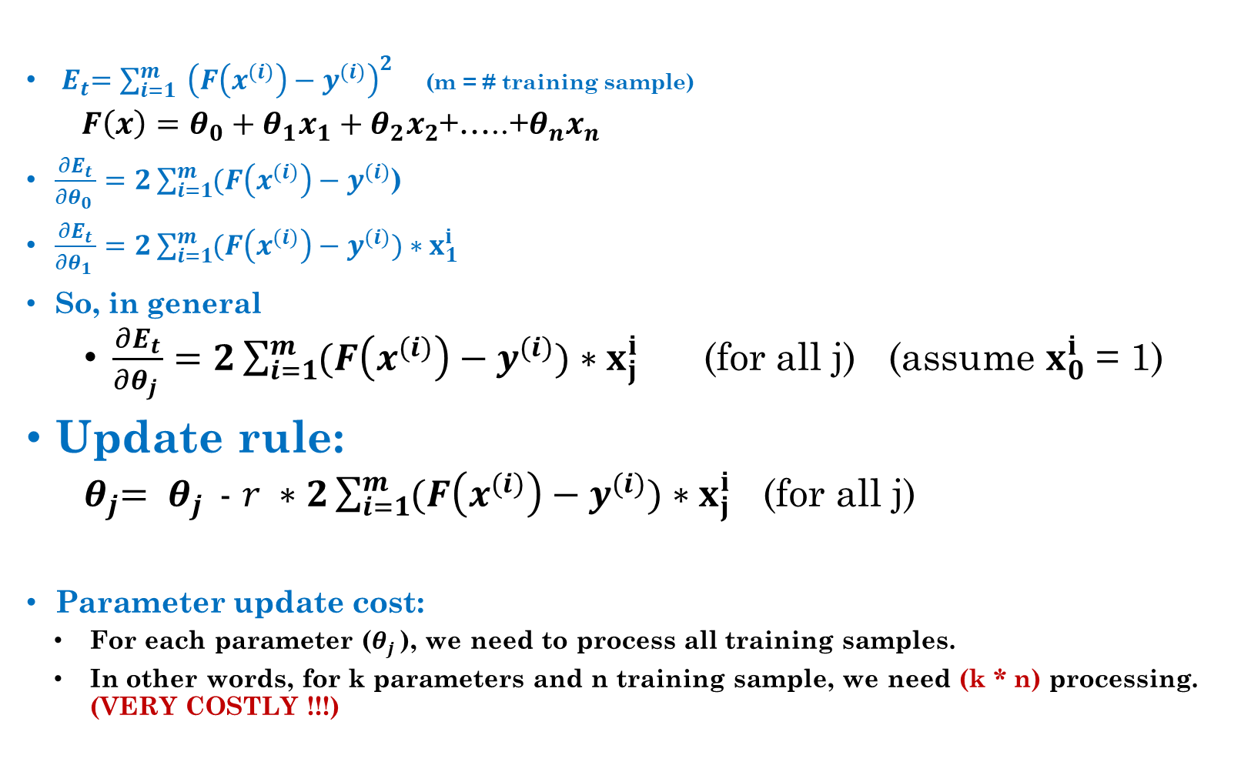
Trouble with Batch Gradient Descent
${ E}_{t}=\sum_{i=1}^{m}{ {\left(F\left(x^{(i)}\right)−y^{(i)}\right)}^{2}}$ (m = # training sample)
$F\left(x\right)=θ_{0}+θ_{1}x_{1}+θ_{2}x_{2}$+…..+$θ_{n}x_{n}$
$\frac{∂E_{t}}{∂θ_{0 }}=2\sum_{i=1}^{m}{(F\left(x^{(i)}\right)−y^{(i)}}$)
$\frac{∂E_{t}}{∂θ_{1 }}=2\sum_{i=1}^{m}{(F\left(x^{(i)}\right)−y^{(i)}})∗x_{1}^{i}$
So, in general
$\frac{∂E_{t}}{∂θ_{j }}=2\sum_{i=1}^{m}{(F\left(x^{(i)}\right)−y^{(i)}})∗x_{j}^{i}$ (for all j) (assume $x_{0}^{i}$ = 1)
Update rule:
${ θ}_{j}= θ_{j }$- $r ∗2\sum_{i=1}^{m}{(F\left(x^{(i)}\right)−y^{(i)}})∗x_{j}^{i}$ (for all j)
Parameter update cost:
For each parameter ($θ_{j }$), we need to process all training samples.
In other words, for k parameters and n training sample, we need (k * n) processing. (VERY COSTLY !!!)

Slide 15
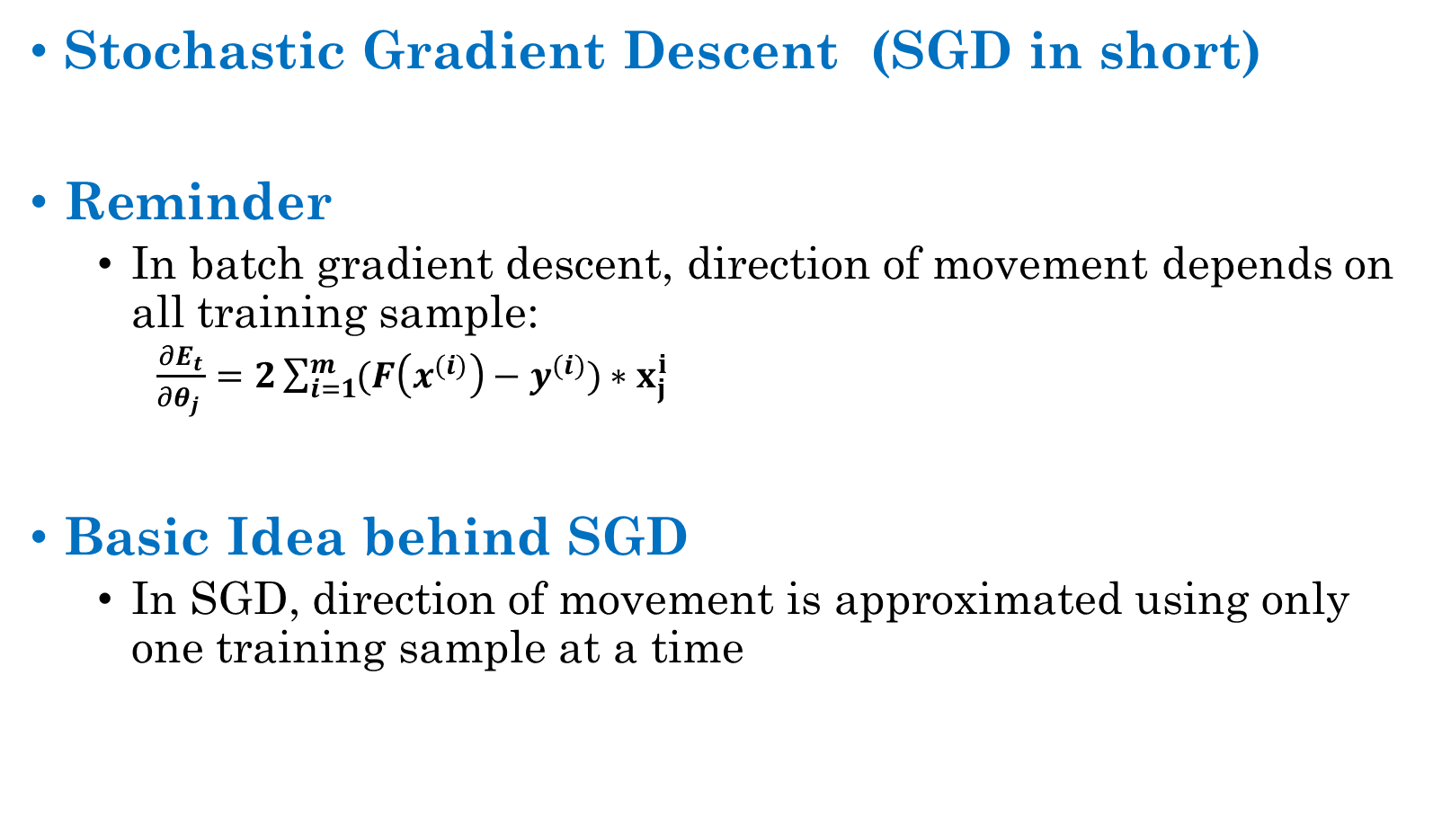
A Practical Solution:
Stochastic Gradient Descent (SGD in short)
Reminder
In batch gradient descent, direction of movement depends on all training sample:
$\frac{∂E_{t}}{∂θ_{j }}=2\sum_{i=1}^{m}{(F\left(x^{(i)}\right)−y^{(i)}})∗x_{j}^{i}$
Basic Idea behind SGD
In SGD, direction of movement is approximated using only one training sample at a time

Slide 16
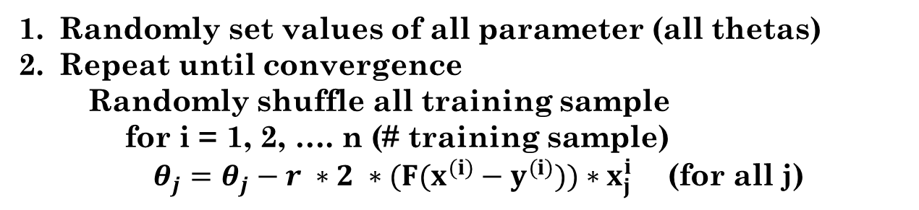
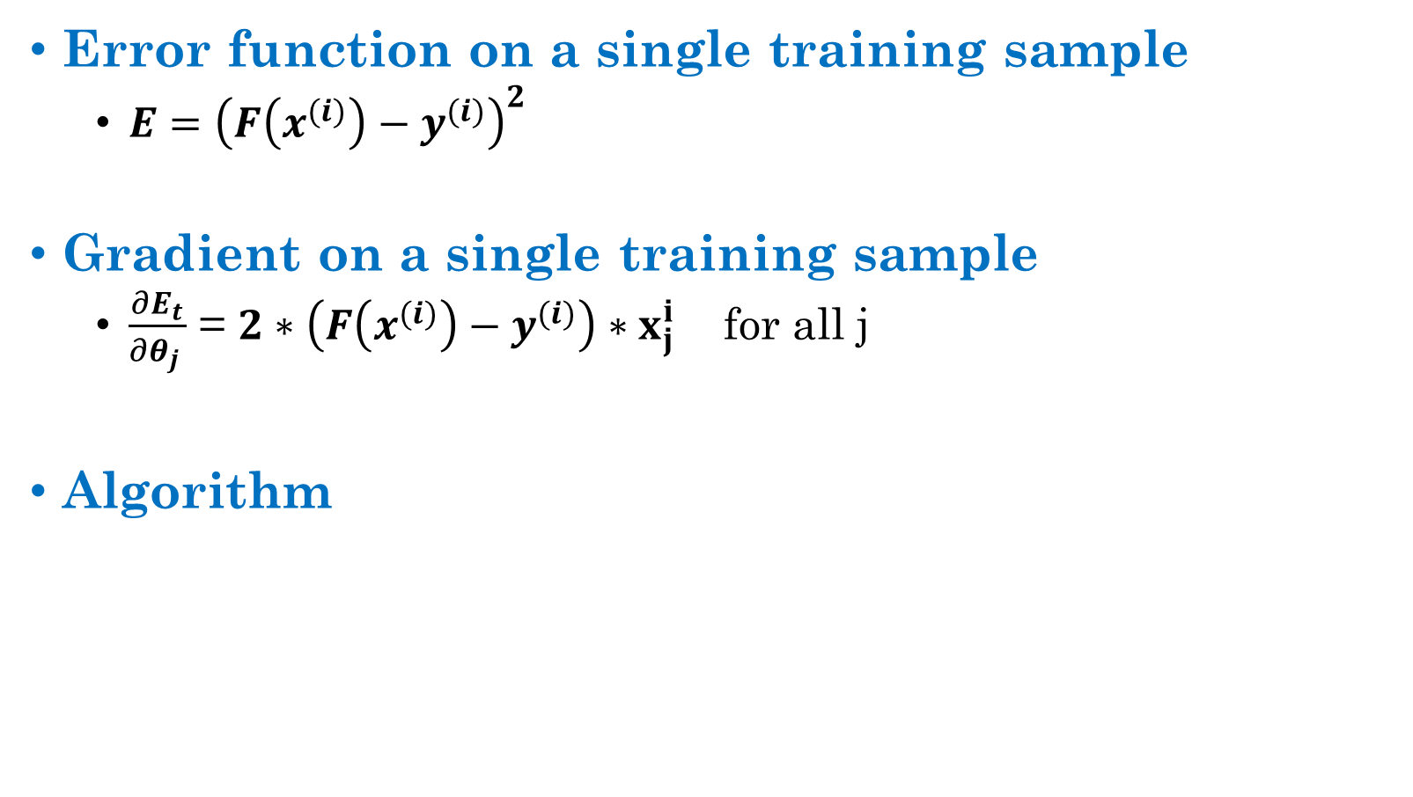
Stochastic Gradient Descent: Algorithm
Error function on a single training sample
$E={\left(F\left(x^{(i)}\right)−y^{(i)}\right)}^{2}$
Gradient on a single training sample
$\frac{∂E_{t}}{∂θ_{j }}$ = $2∗\left(F\left(x^{(i)}\right)−y^{(i)}\right)∗x_{j}^{i}$ for all j
Algorithm
Randomly set values of all parameter (all thetas)
Repeat until convergence
Randomly shuffle all training sample
for i = 1, 2, …. n (# training sample)
$θ_{j}=θ_{j}−r ∗2 ∗(F(x^{(i)}−y^{(i)}))∗x_{j}^{i}$ (for all j)

Slide 17
Mini Batch SGD

Slide 18
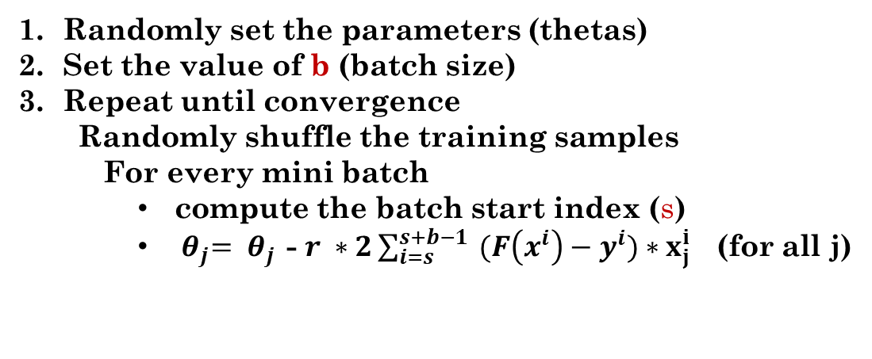
Mini-Batch SGD
Basic Idea
Compute gradient on a batch of b training samples
Algorithm
batch size, b = 1000 (for example)
Randomly set the parameters (thetas)
Set the value of b (batch size)
Repeat until convergence
Randomly shuffle the training samples
For every mini batch
compute the batch start index (s)
${ θ}_{j}= θ_{j }$- $r ∗2\sum_{i=s}^{s+b−1}{ (F\left(x^{i}\right)−y^{i}})∗x_{j}^{i}$ (for all j)

Slide 19
Summary of Gradient Descent
Batch Gradient Descent
Gradient is computed using all training samples
Stochastic Gradient Descent
Gradient is computed using only one training sample at a time
Mini-batch Gradient Descent
Gradient is computed on a small batch (say 100) of training samples

Slide 20
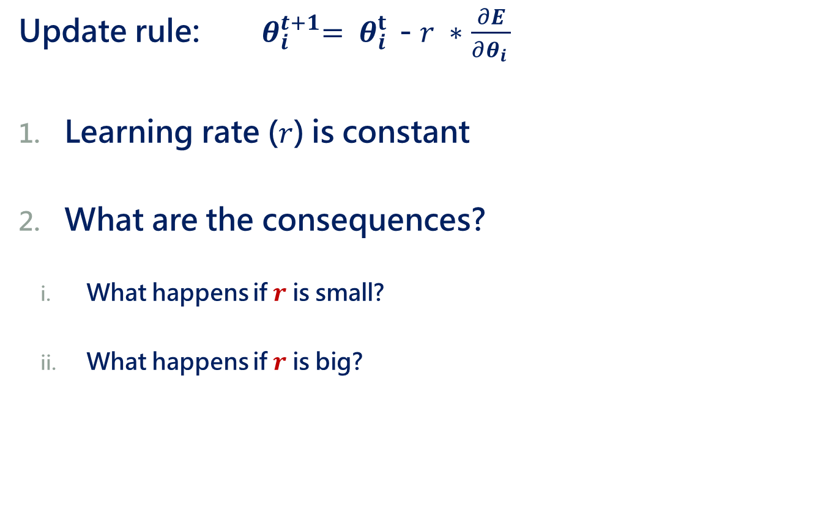
Limitations of Gradient Descent
Update rule: ${ θ}_{i}^{t+1}= θ_{i }^{t}$- $r ∗$ $\frac{∂E}{∂θ_{i }}$
Learning rate ($r$) is constant
What are the consequences?
What happens if $r$ is small?
What happens if $r$ is big?

Slide 21
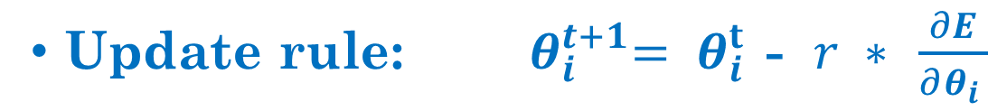
What happens for different $r$ ?
Small value of r => slow convergence

Slide 22
What happens for different $r$?
Small value of r
Large value of r
Oscillation / overshooting

